Slide 1
Power Supplies for Mechatronics Systems
Subhas Mukhopadhyay, FIEEE, FIEE, FIETE
Professor of Mechanical/Electronics Engineering
School of Engineering, Macquarie University, Australia

Slide 2
Sources of power for DC motors
Batteries
AC Power Supply >> DC power Supply

Slide 3













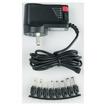
Power supplies
1. Power from Batteries
2. Power from supply mains: 100 V, 230 V
50 Hz or 60 Hz
Output voltages: 3 V, 4.5 V, 6 V, 7.5 V, 9 V and 12 V

Slide 4
Batteries

Slide 5
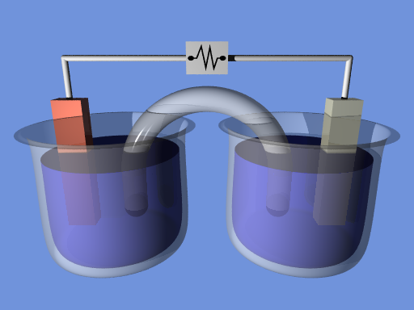
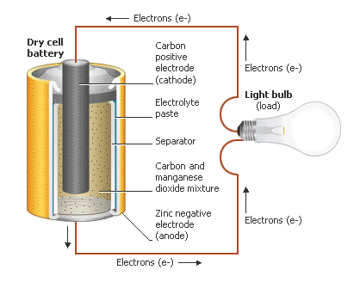
How Electrochemical Batteries Work
REDOX Reaction
Oxidation, the loss of electrons, occurs at the anode.
Reduction, the gain of electrons, occurs at the cathode.
Primary Batteries – Disposable
Secondary Batteries – Rechargeable
emf – Electromotive force, voltage
Ampere∙hour (Ah) = 3600 coulombs, a measure of electric charge
Watt ∙hour (Wh) = 3600 joules, a measure of energy
Ah = (Wh) / emf
Electron Flow →
Anode
Salt Bridge
Cathode
-
-
+
-
-
+
+
Electrolyte
Electrolyte
Notes:
For electrochemical cells; some batteries do not work this way
Red – Anode, where the electrolyte loses electrons (oxidizes)
Blue – Cathode, where the electrolyte gains electrons (reduces)
Charge balance must be maintained, thus the salt bridge. Can be a porous barrier between the two electrolytes; just has to keep ions in the electrolytes from touching the opposite electrodes. Can use the same electrolyte, but they shouldn’t touch.
As the anode loses electrons, negative ions (anions) from the salt bridge, or other electrolyte if barrier used, travel to the anode solution, and positive ions (cations) travel to the cathode.
May see voltage refered to as EMF, electromotive force.

Slide 6
The Electrochemical Cell
Zinc is (much) more easily oxidized than Copper
Salt bridge only carries negative ions
This is the limiting factor for current flow
Pick a low-resistance bridge

Slide 7
The Electrochemical Series
Most wants to reduce (gain electrons)
Gold
Mercury
Silver
Copper
Lead
Nickel
Cadmium
Iron
Zinc
Aluminum
Magnesium
Sodium
Potassium
Lithium
Most wants to oxidize (lose electrons)

Slide 8
History of battery:
The Nickel-Cadmium Battery
Invented in 1899 by Waldmar Jungner.
The common Alkaline Battery
Invented in 1955 by Lewis Urry
The Nickel Metal-Hydrid Battery
NiMH batteries for smaller applications started to be on the market in 1989.
Lithium and Lithium-ion Batteries
First lithium batteries sold in the 1970s
First lithium-ion batteries sold in 1991
First lithium-ion polymer batteries released in 1996

Slide 9
Battery Characteristics
Size
Physical: button, AAA, AA, C, D, ...
Energy density (watts per kg or cm³)
Longevity
Capacity (Ah, for drain of C/10 at 20°C)
Number of recharge cycles
Discharge characteristics (voltage drop)
Cost
Behavioral factors
Temperature range (storage, operation)
Self discharge
Memory effect
Environmental factors
Leakage, gassing, toxicity
Shock resistance

Slide 10
Main specifications
 | AAA | AA | 9V | C | D
Capacity (Ah) | 1.250 | 2.890 | 0.625 | 8.350 | 20.500
Voltage | 1.5 | 1.5 | 9 | 1.5 | 1.5
Energy (Wh) | 1.875 | 4.275 | 5.625 | 12.525 | 30.75

Slide 11
Batteries – a short description
Nickel Cadmium (NiCd) — mature and well understood but relatively low in energy density. The NiCd is used where long life, high discharge rate and economical price are important. Main applications are two-way radios, biomedical equipment, professional video cameras and power tools. The NiCd contains toxic metals and is environmentally unfriendly.
Nickel-Metal Hydride (NiMH) — has a higher energy density compared to the NiCd at the expense of reduced cycle life. NiMH contains no toxic metals. Applications include mobile phones and laptop computers.
Lead Acid — most economical for larger power applications where weight is of little concern. The lead acid battery is the preferred choice for hospital equipment, wheelchairs, emergency lighting and UPS systems.
Lithium Ion (Li‑ion) — fastest growing battery system. Li‑ion is used where high-energy density and lightweight is of prime importance. The technology is fragile and a protection circuit is required to assure safety. Applications include notebook computers and cellular phones.
Lithium Ion Polymer (Li‑ion polymer) — offers the attributes of the Li-ion in ultra-slim geometry and simplified packaging. Main applications are mobile phones.

Slide 12
Discharge of a battery:
C Rating Background
C Rate is derived from Coulomb’s Law developed by French physicist Charles Augustin de Coulomb. The C-rate is the governing measurement of what current a battery is charged or discharged at. For example, the mAh of Ah of the battery is the 1C rating. If a battery is labelled 2000mAh, then its 1C rating is 2000mAh.
To make this simple, the battery should provide 1C current for one hour. In our example above that would be 2000mAh or 2A of current for one hour. The same applies for a 0.5C rating. Again using the 2000mAh battery, it would deliver 1000mAh or 1A of current for two hours.
Battery C Rating Examples
The formulas for the example are simple. 1600mAh battery with a 10C rating.
Continuous Discharge (mAh / 1000) x C Rate = Continuous Discharge Amperage (1600 / 1000) x 10 = 16A
Run Time for Safe Continuous Discharge 60mins / C-Rate = Run Time 60mins / 10C = Discharge 16A for 6mins

Slide 13
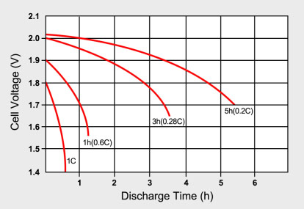

Slide 14
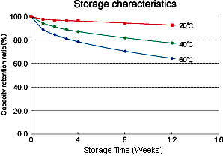

Slide 15
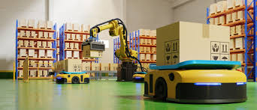
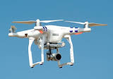
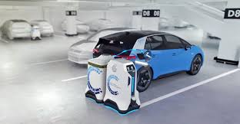
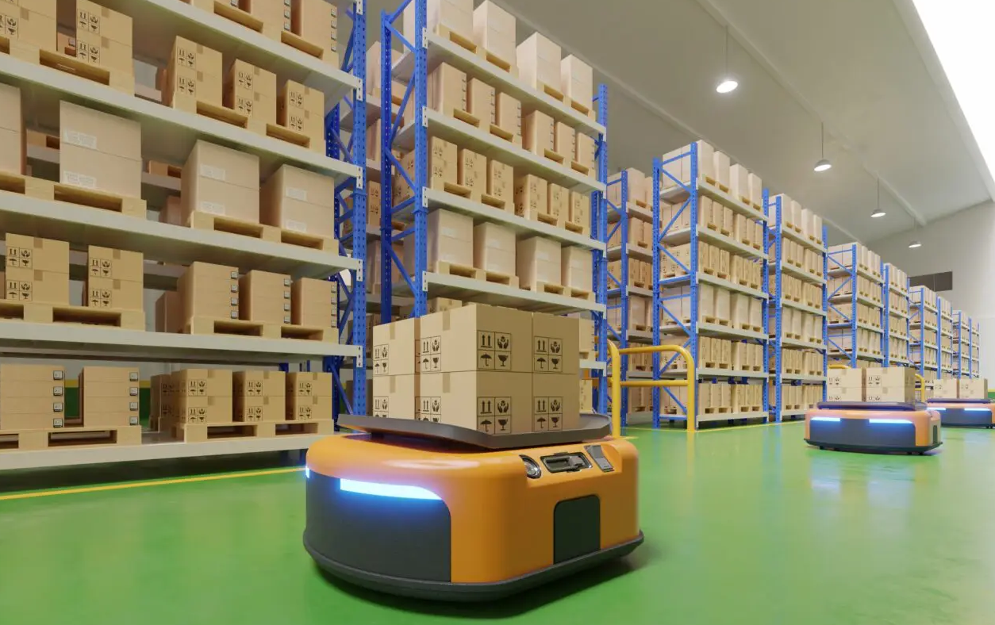
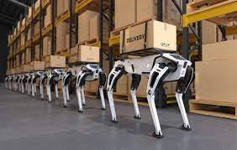
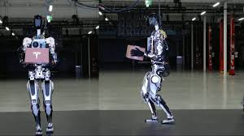
Some applications of batteries

Slide 16

Calculation of Battery Capacity
Assuming the current required = 0.75A
Assume utilization efficiency is 75%.
Back-up Time (Hr(s)) | Required Ah
1 | 1.0
2 | 2.0
4 | 4.0
8 | 8.0
12 | 12.0
24 | 24.0
48 | 48.0
72 | 72.0
Notes:
Safety factor

Slide 17
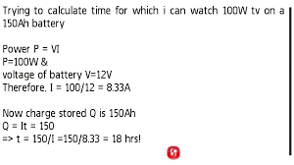
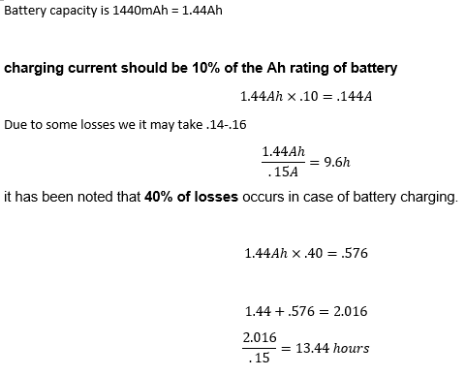
Battery Discharging and Charging
Considering utilisation less than 100%, the actual time of usage will be less than the calculated value of 18 hours.

Slide 18
DC Power Supply
All mechatronics systems need a power source to work.
For electronic circuits made up of transistors and/or ICs, this power source must be a DC voltage of a specific value.
A battery is a common DC voltage source for some small mechatronics equipment especially portables like toy cars, Roomba vacuum cleaners, drones etc.
Most non-portable equipment uses power supplies that operate from the AC power line but produce one or more DC outputs.

Slide 19
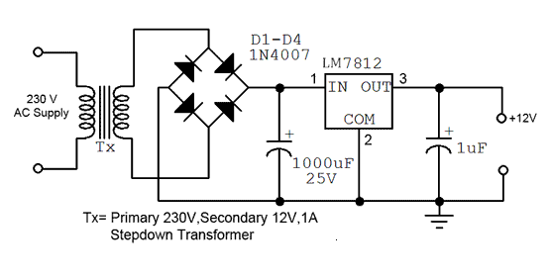
A typical Power Supply for Low-power DC motors
The input is the 230 volt 50 Hz AC supply.
The power supply converts the AC into DC and provides one or more DC output voltages.
Some modern electronic circuits need two or more different voltages.
Common voltages are 48, 24, 15, 12, 9, 5, 3.3, 2.5, 1.8, 1.5, 1.2 and 1 volts.
A good example of a modern power supply is the one inside a PC that furnishes 12, 5, 3.3 and 1.2 volts.
Wired power vs battery power?

Slide 20
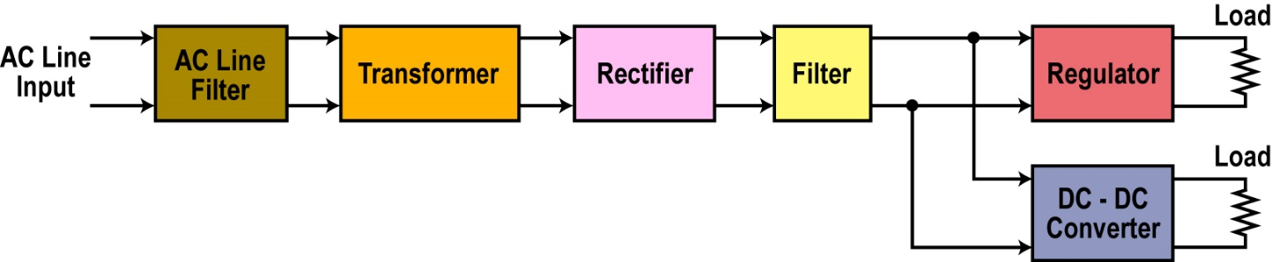
Components of a Power Supply
Main circuits in most power supplies.

Slide 21
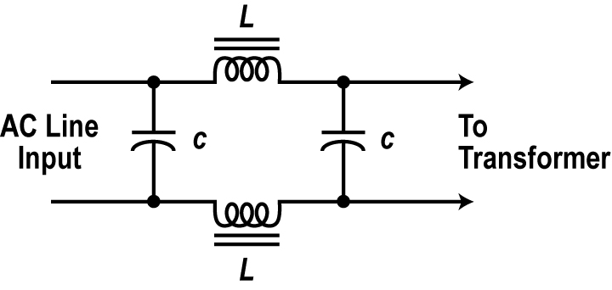
Line Filter
The AC line is first passed through a low pass filter of the form shown in figure.
This eliminates noise on the AC line from bothering the power supply circuits and prevents unwanted signals from the power supply from being transferred back into the AC line where they might interfere with other equipment.

Slide 22

Transformer
A transformer is commonly used to step the input AC voltage level down or up. Most electronic circuits operate from voltages lower than the AC line voltage so the transformer normally steps the voltage down by its turns ratio to a desired lower level.
For example, a transformer with a turns ratio of 20 to 1 would convert the 230 volt 50 Hz input sine wave into a 11.5 volt sine wave.

Slide 23
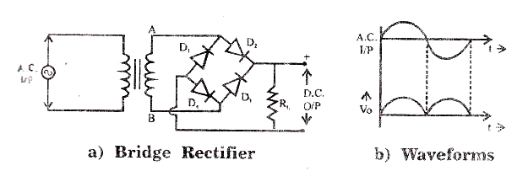
Rectifier
The rectifier converts the AC sine wave into a pulsating DC wave.
There are several forms of rectifiers used but all are made up of diodes.
Rectifier types and operation depends on the design and configurations.

Slide 24
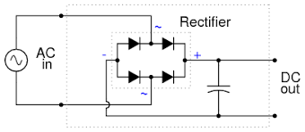
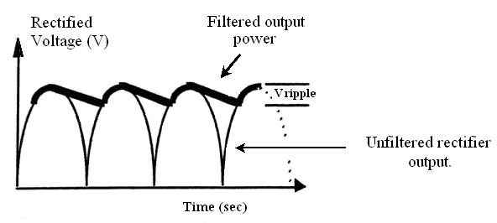
Filter
The rectifier produces a DC output but it is pulsating rather than a constant steady value over time like that from a battery.
A filter is used to remove the pulsations and create a constant output.
The most common filter is a large capacitor.

Slide 25
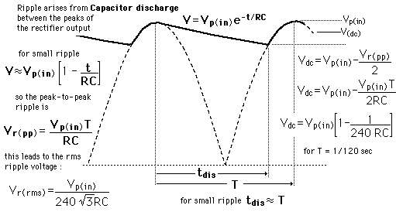
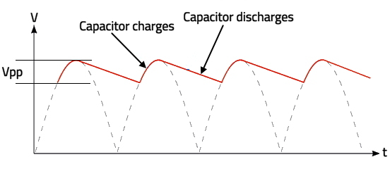
Ripple
The capacitor does smoothing the pulses from the rectifier into a more constant DC.
A small variation occurs in the DC because the capacitor discharges a small amount between the positive and negative pulses. Then it recharges. This variation is called ripple.
The ripple can be reduced further by making the capacitor larger.
The ripple appears to be a sawtooth shaped AC variation riding on the DC output.
A small amount of ripple can be tolerated in some circuits but the lower the better overall.

Slide 26
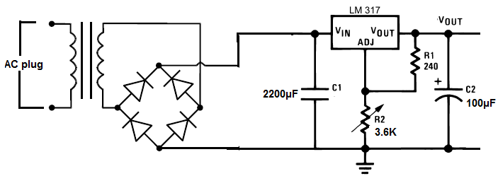
Regulator
The regulator helps maintain a fixed or constant output voltage.
Changes in the load or the AC line voltage will cause the output voltage to vary.
Most electronic circuits cannot withstand the variations since they are designed to work properly with a fixed voltage.
The regulator fixes the output voltage to the desired level then maintains that value despite any output or input variations.

Slide 27
The Regulator
Most regulators are ICs .
These are feedback control circuits that actually monitor the output voltage to detect variations.
If the output varies, for whatever reason, the regulator circuit automatically adjusts the output back to the set value.
Regulators hold the output to the desired value.
Since ripple represents changes in the output, the regulator also compensates for these variations producing a near constant DC output.
Size
Efficiency
Cost
Issues of Rectified DC Power

Slide 28
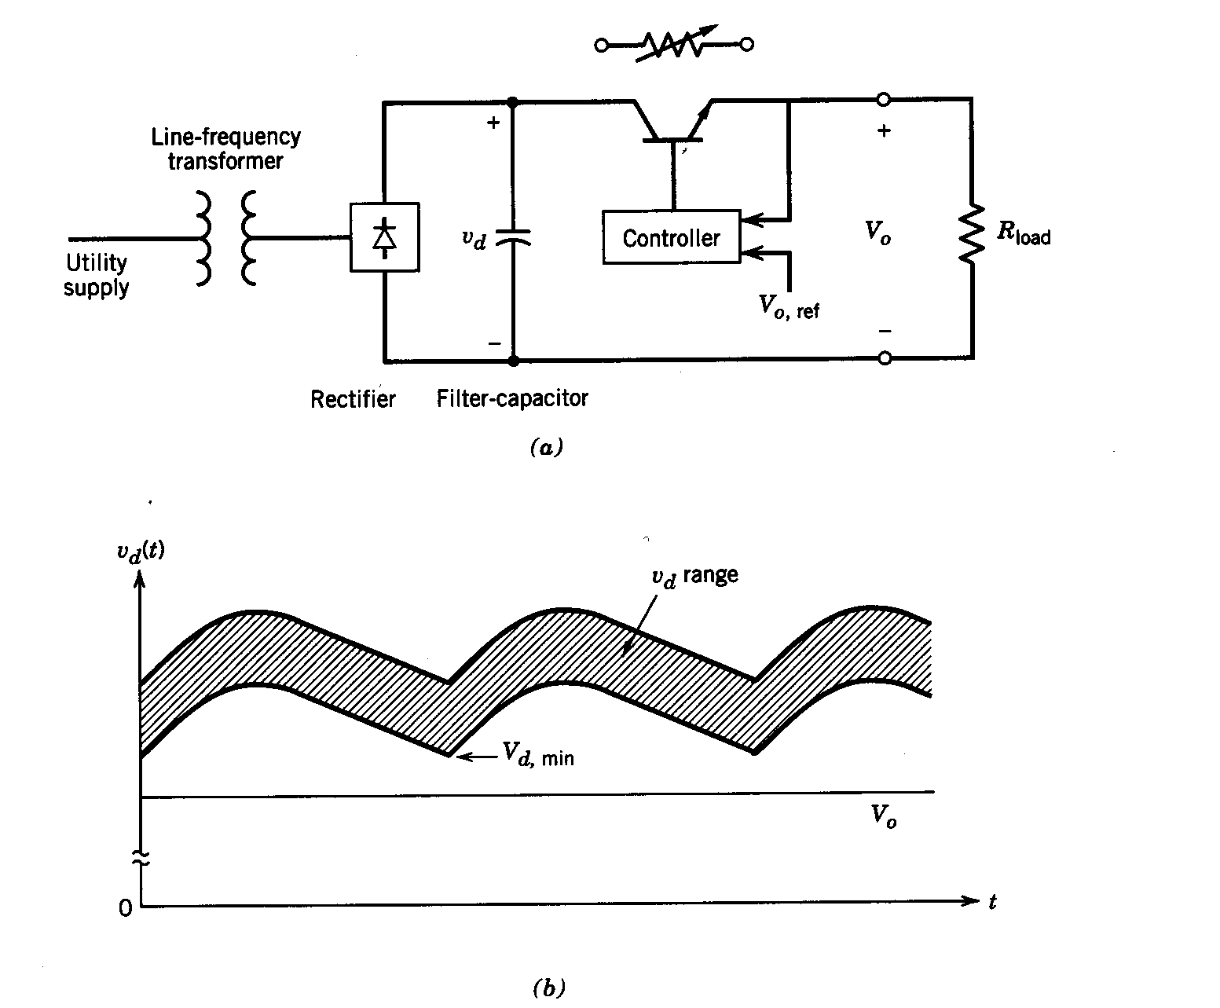
Linear power supply
Demerits
* Series transistor as an adjustable resistor
* Low Efficiency
* Heavy and bulky

Slide 29
DC-DC Converter
Most modern power supplies also contain one or more DC-DC converters
Modern electronics often demand different voltages to function.
A DC-DC converter changes one DC voltage to another, higher or lower DC voltage.
A DC-DC converter is used with a power supply to prevent the need for a second AC-DC supply.

Slide 30
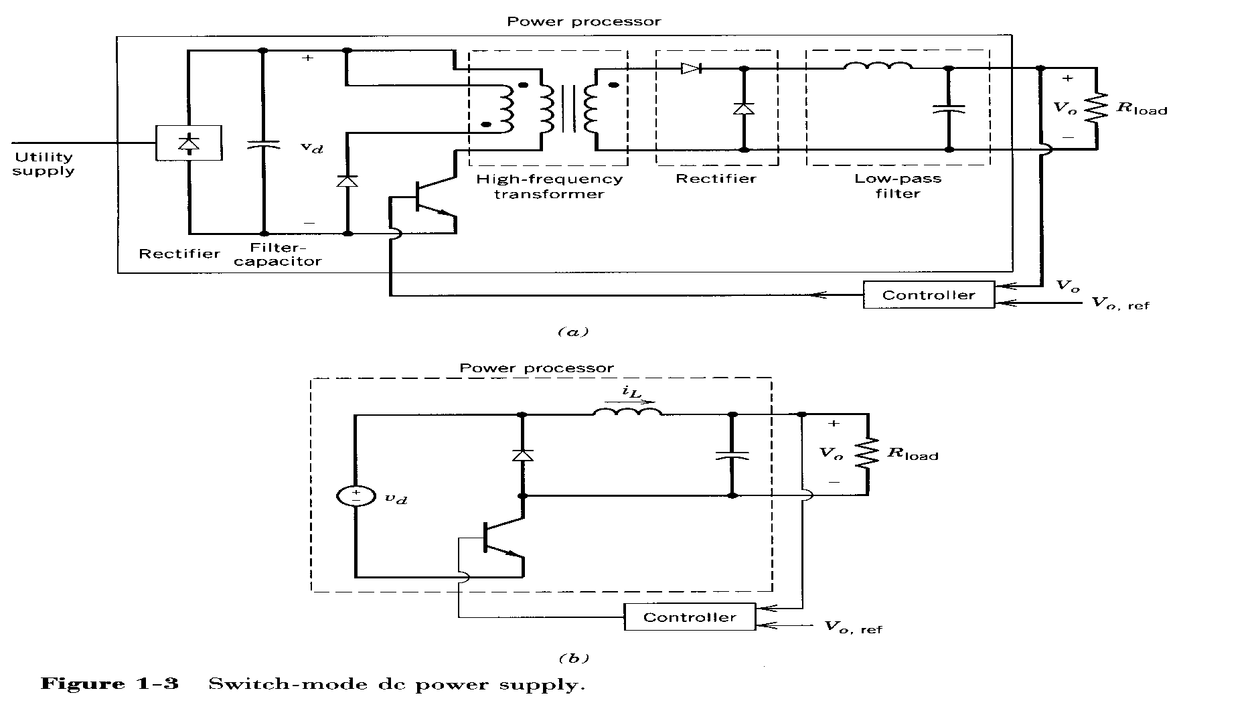
Switched Mode Power Supply
Transistor as a switch
High Efficiency
High-Frequency Transformer

Slide 31
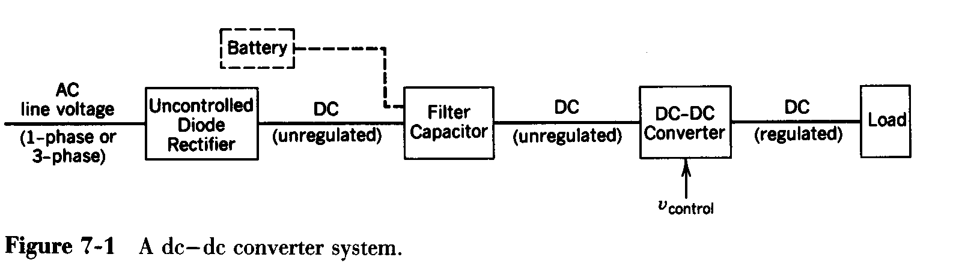
Block Diagram of DC-DC Converters

Slide 32
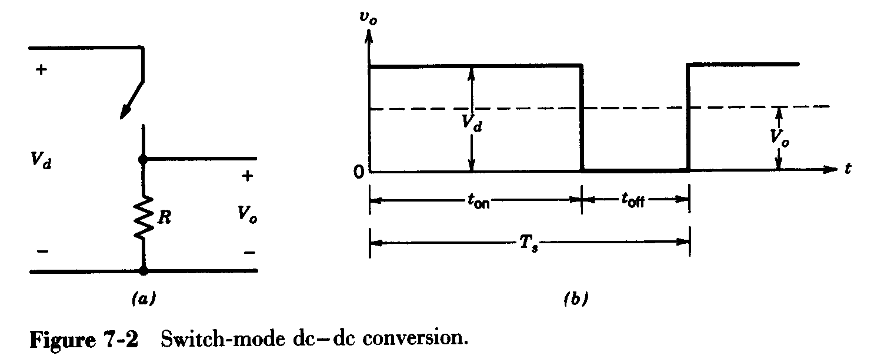
Stepping down a dc voltage

Slide 33
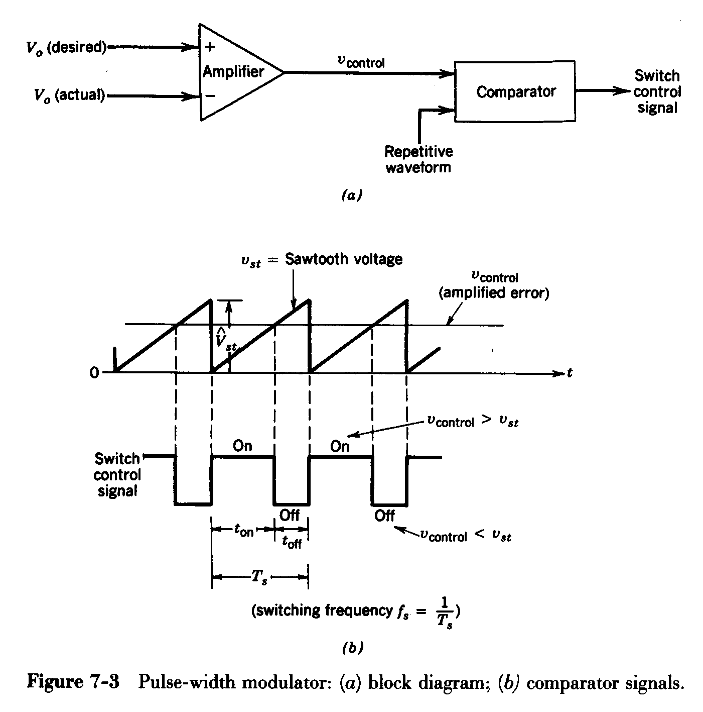
Pulse-Width Modulation in DC-DC Converters
Role of PWM

Slide 34
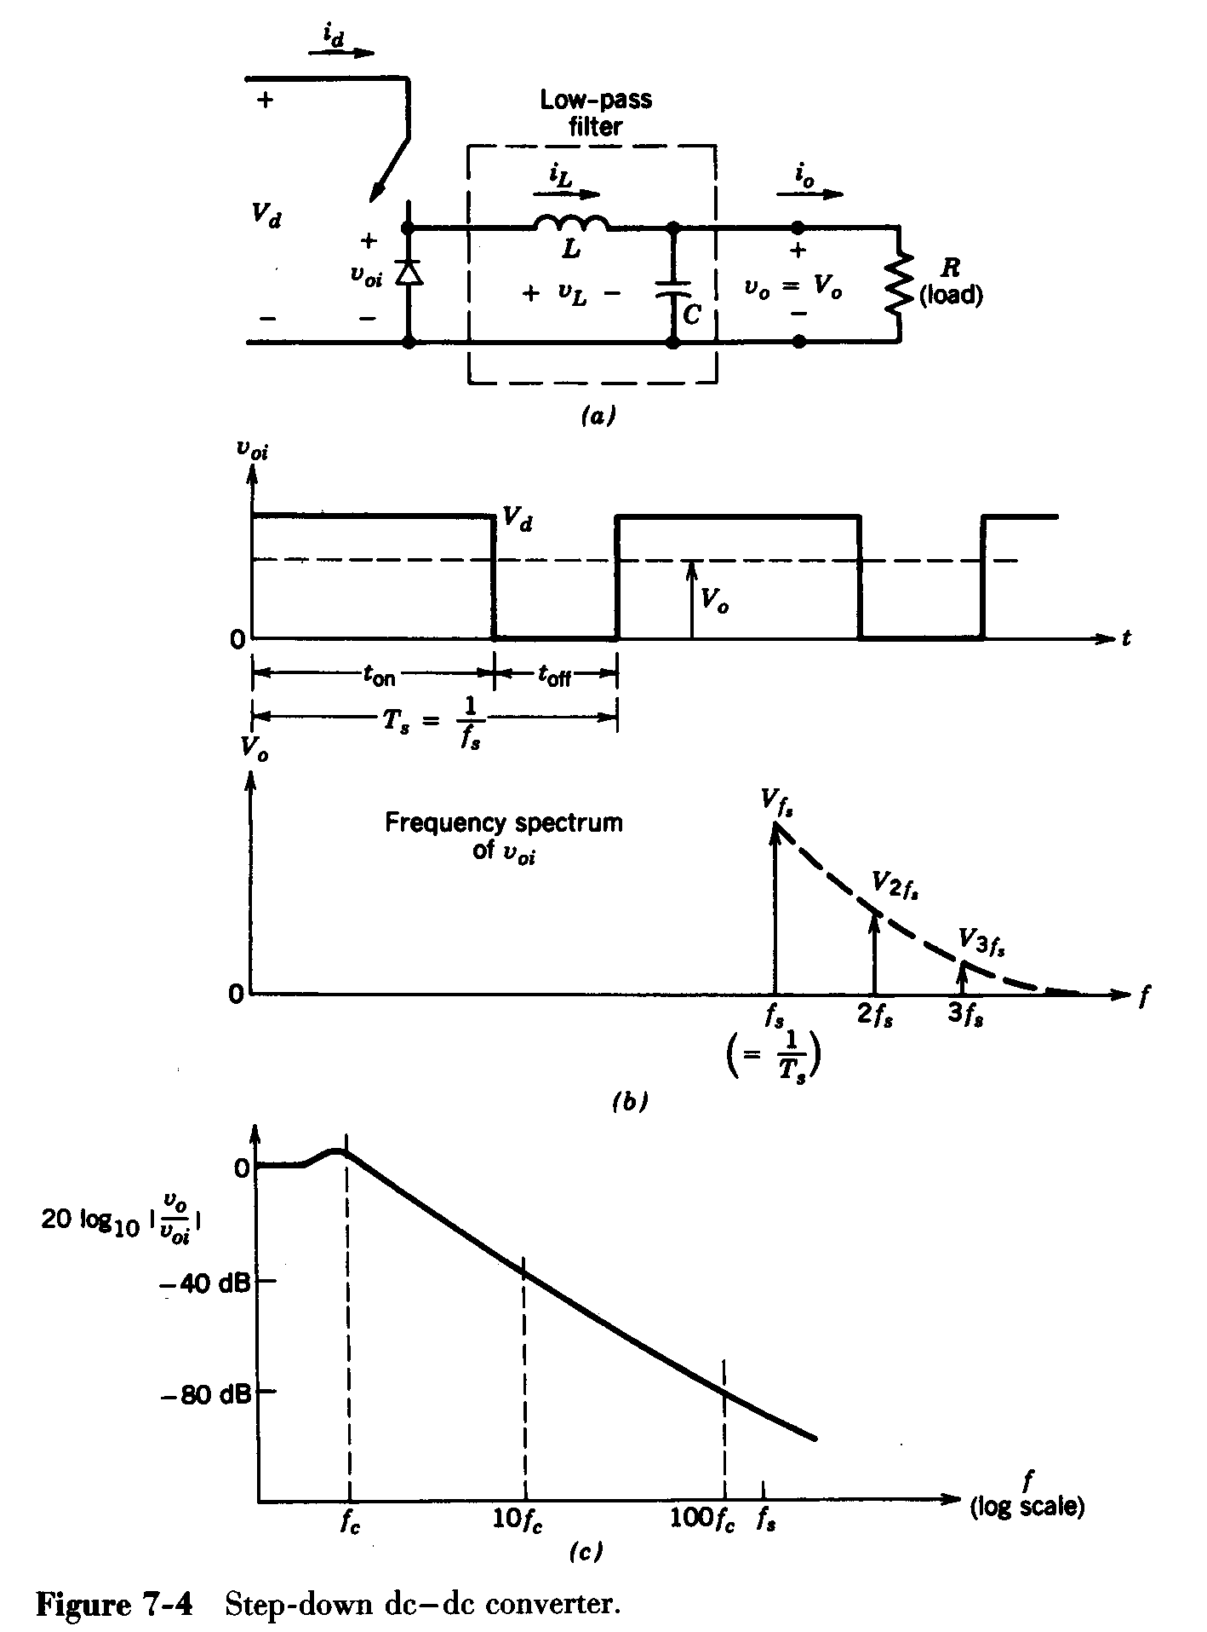
Step-down DC to DC converter (BUCK)
Pulsating input to the low-pass filter

Slide 35
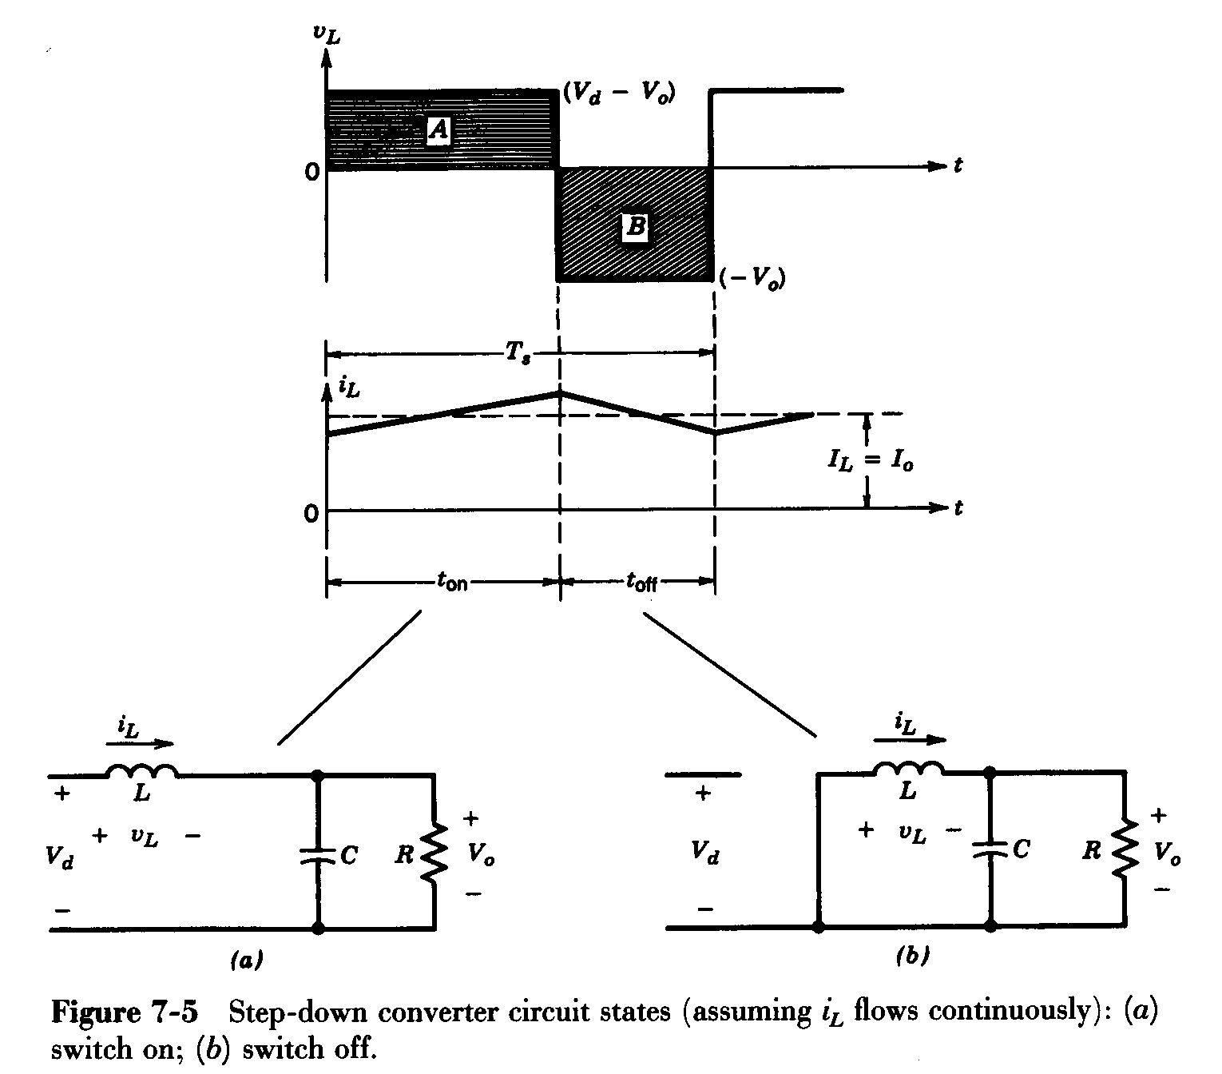
BUCK converter: Waveforms
Steady state; inductor current flows continuously

Slide 36
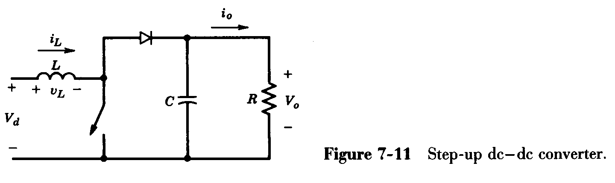
Step-up DC to DC converter (Boost)
The output voltage must be greater than input voltage

Slide 37
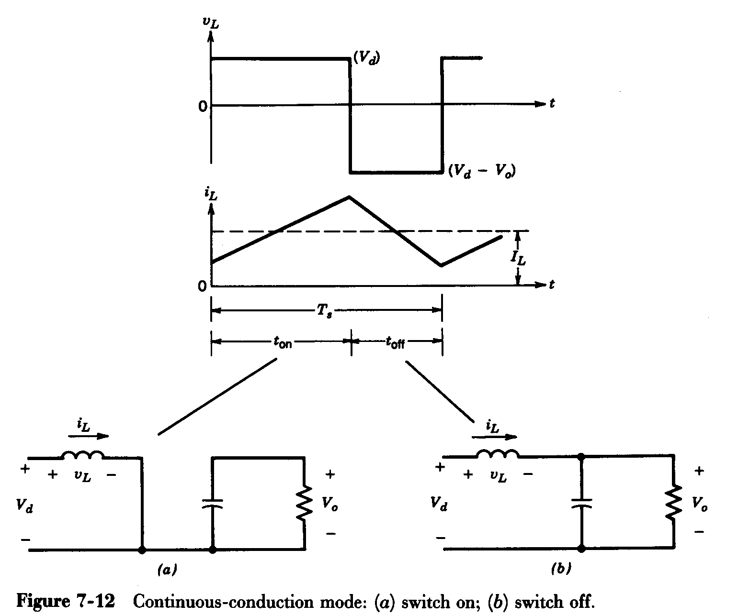
BOOST converter: Waveforms
Continuous current conduction mode

Slide 38
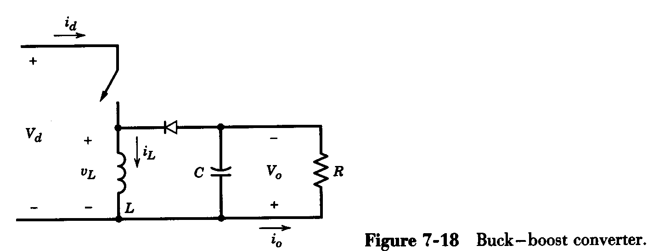
Step-up/down (Buck-Boost) DC to DC converter
The output voltage can be greater or lower than the input voltage

Slide 39
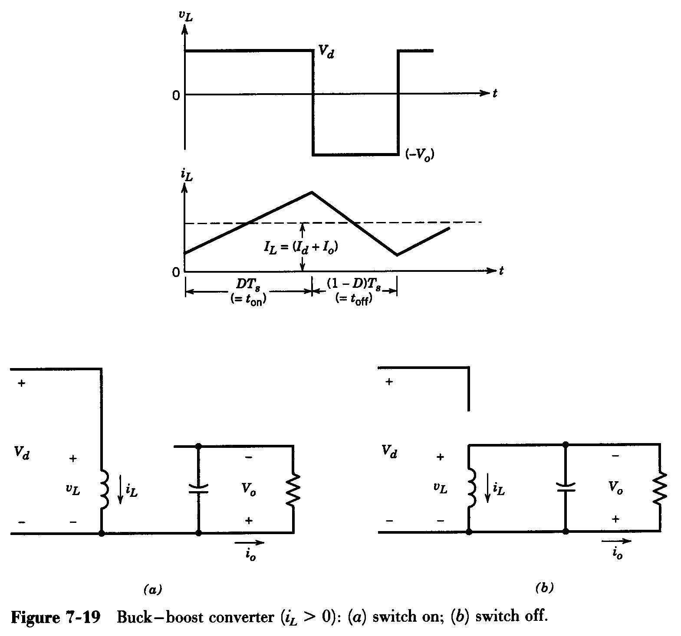
Buck-boost converter: waveforms
Continuous conduction mode

Slide 40
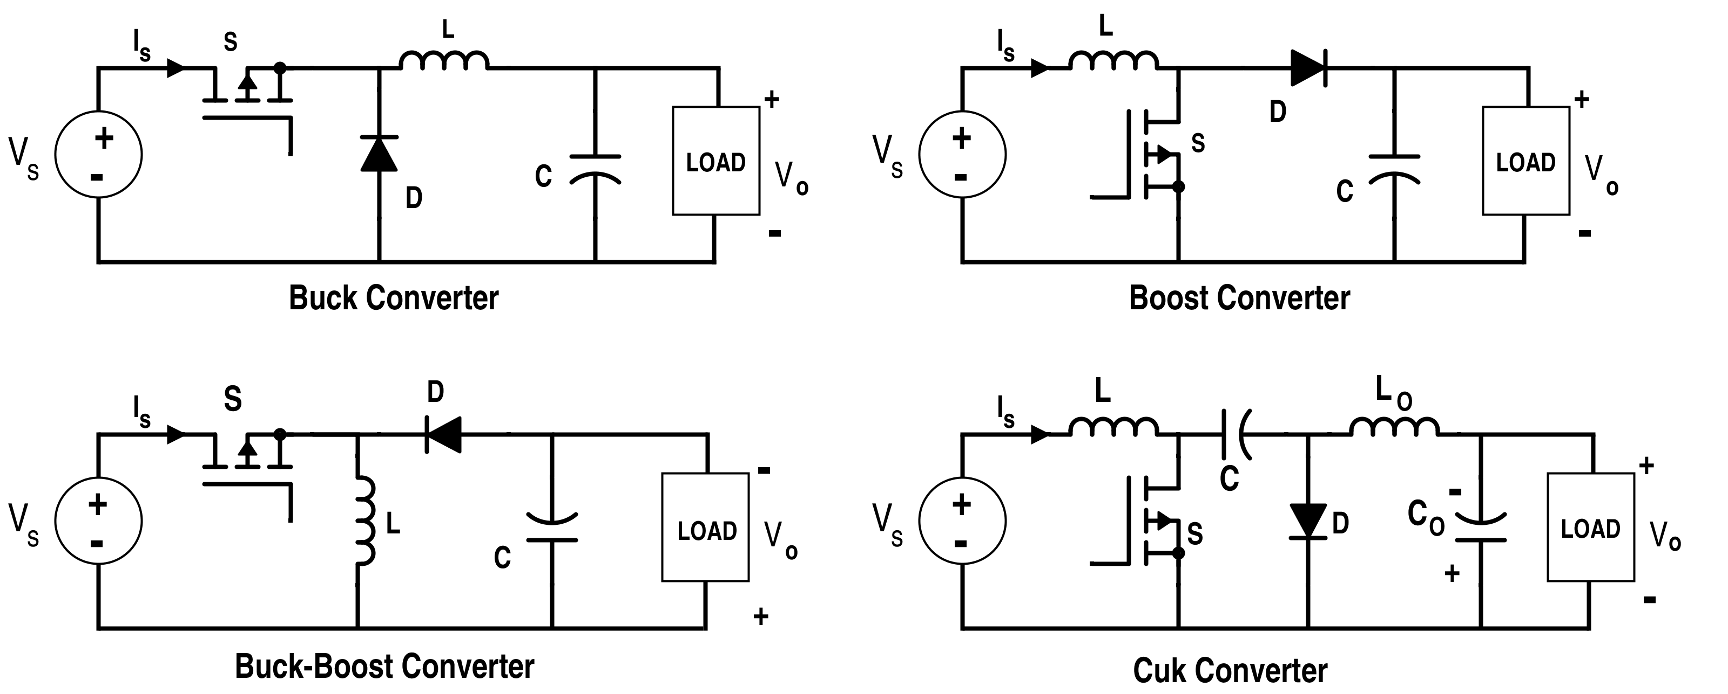
Power Circuit configuration of DC to DC Converters

Slide 41
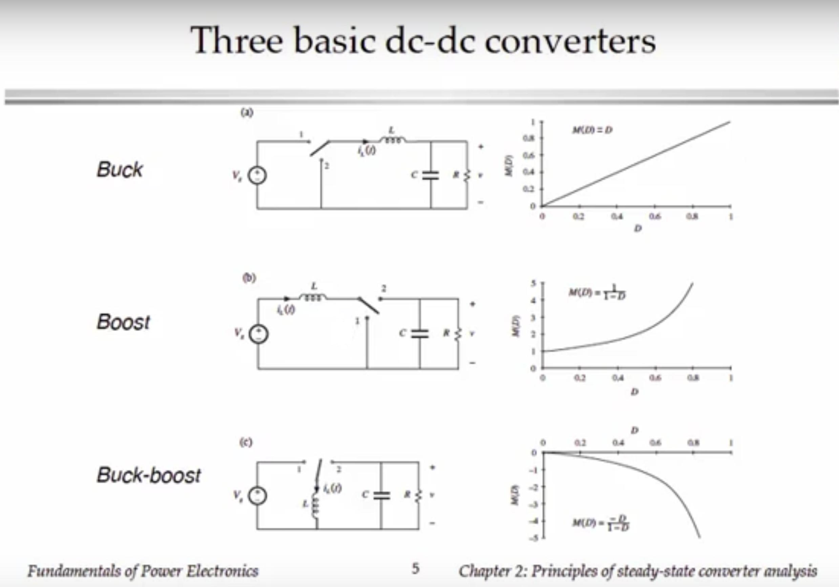

Slide 42
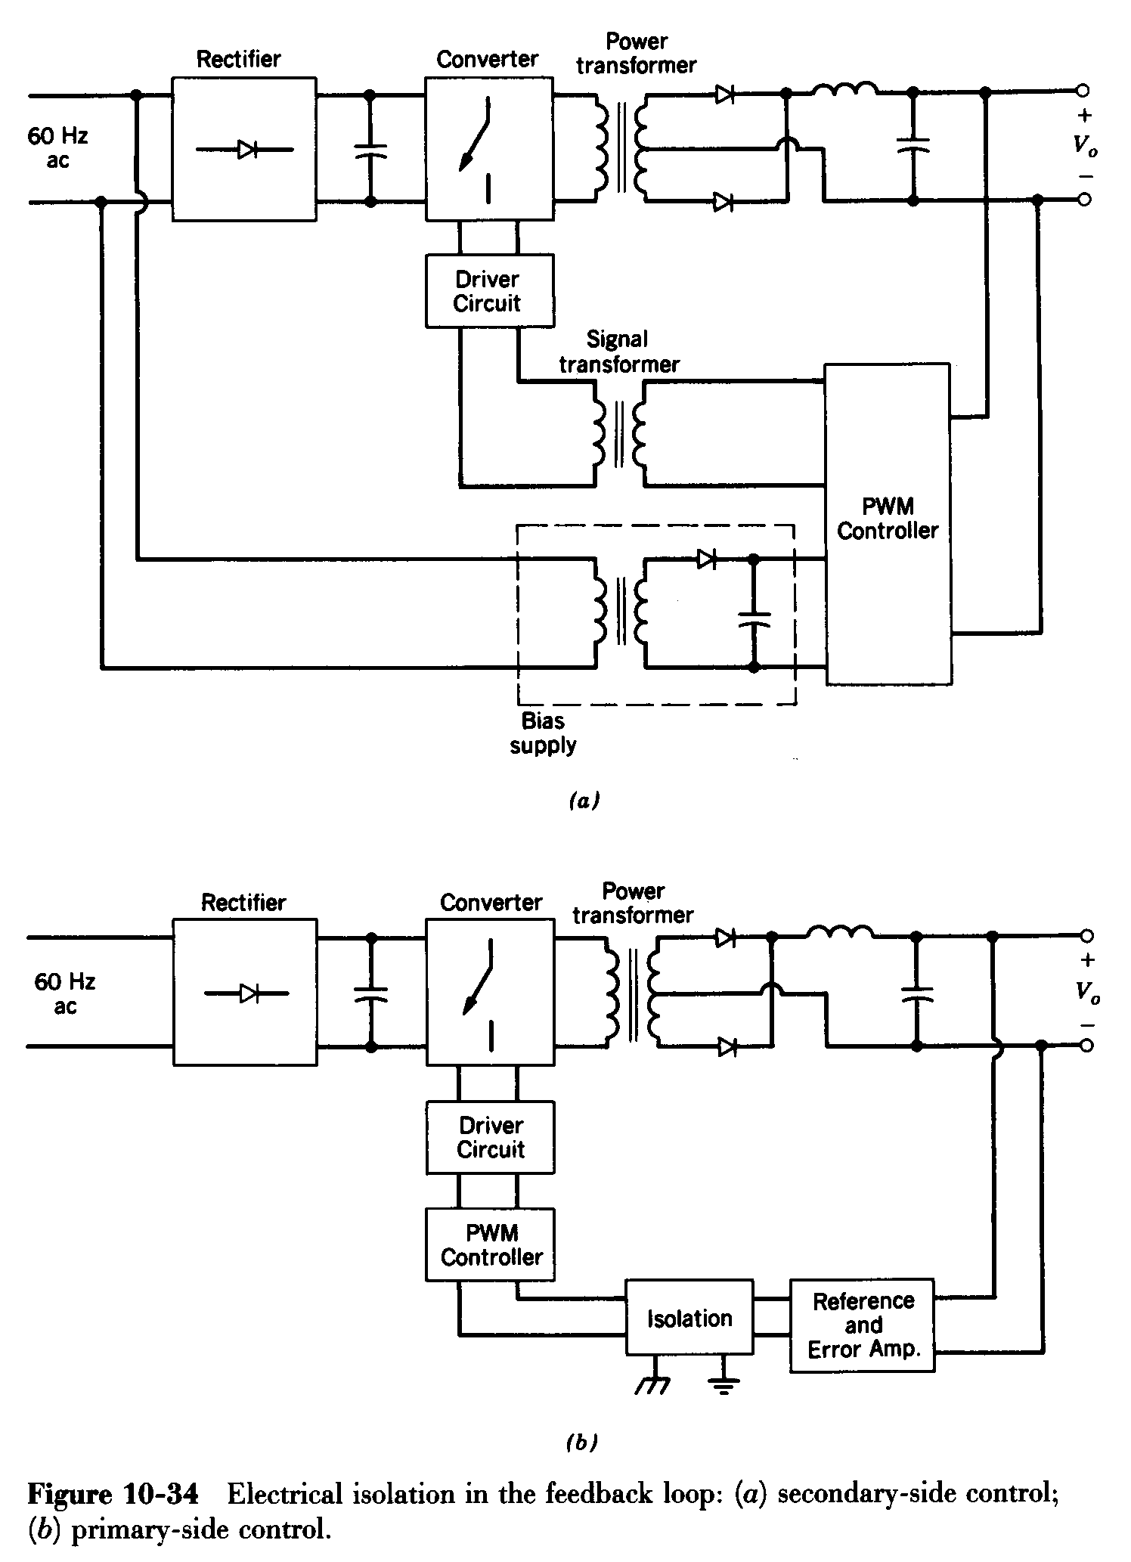
Implementing Electrical Isolation in the Feedback Loop
Two ways are shown

